Slide 1
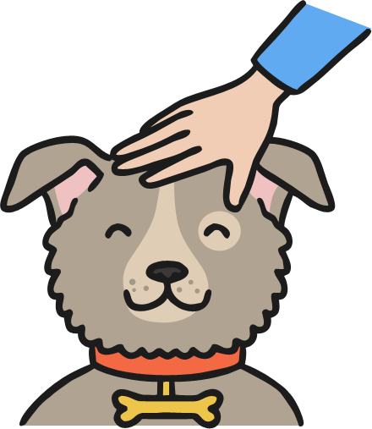
pat a dog

Slide 2
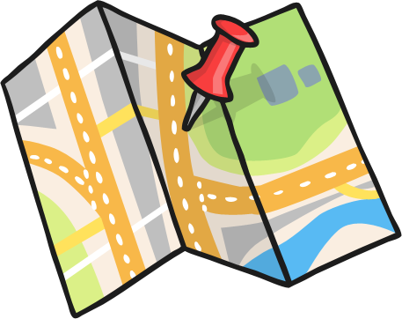
a pin on a map

Slide 3
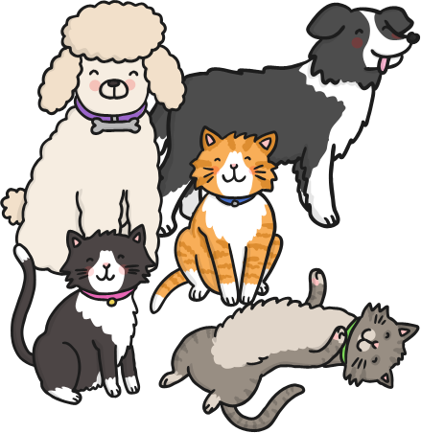
cats and dogs

Slide 4
cat in a hat

Slide 5
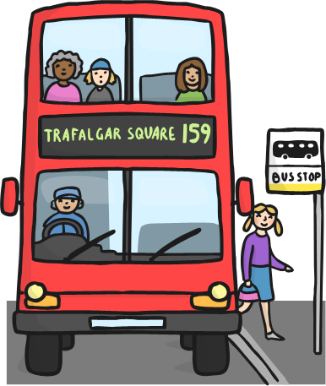
get off the bus

Slide 6
a kid in a cap

Slide 7
a bag of nuts

Slide 8
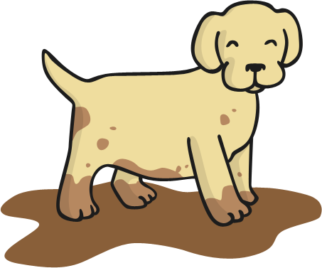
a pup in the mud

Slide 9
a sad man

Slide 10
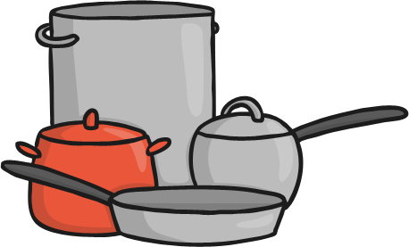
pots and pans

Slide 11
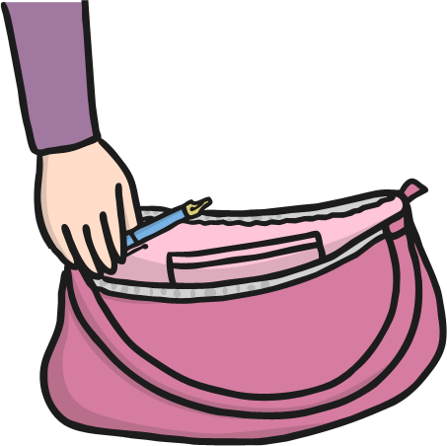
pack a pen
in a bag

Slide 12
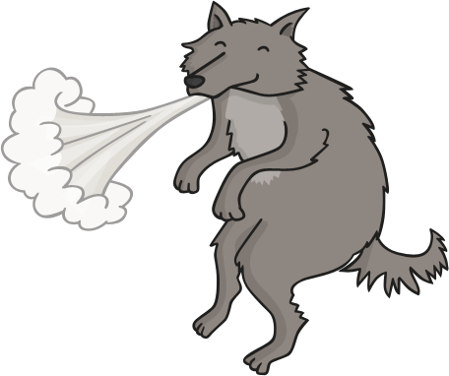
to huff and puff

Slide 13
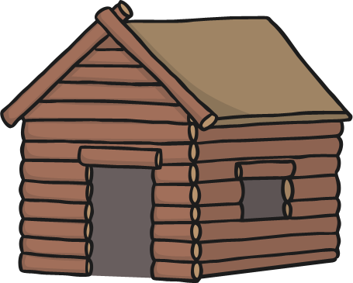
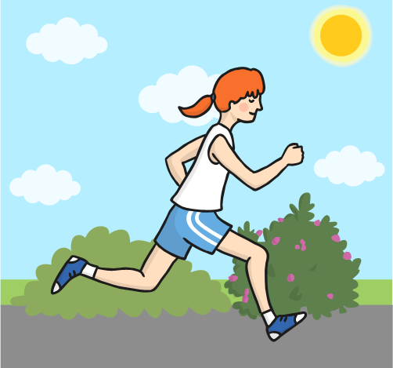
run to the den

Slide 14
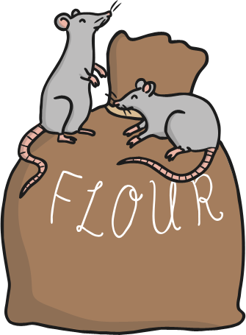
rats on a sack

Slide 15
get to the top

Slide 16
a tin can

Slide 17
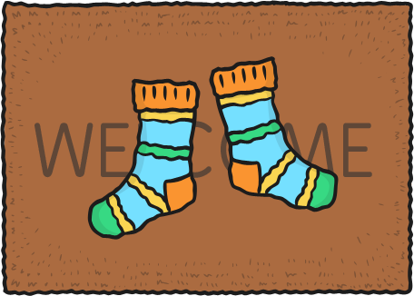
socks on a mat

Slide 18
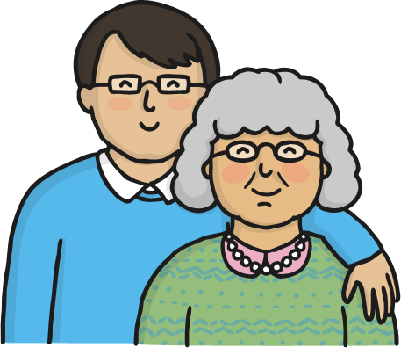
dad and nan

Slide 19
a run in the sun

Slide 20
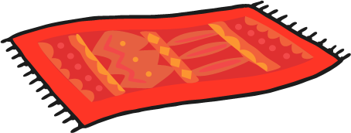
a red rug

Slide 21
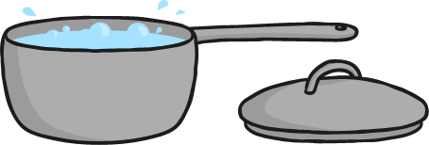
no lid on the pan

Slide 22
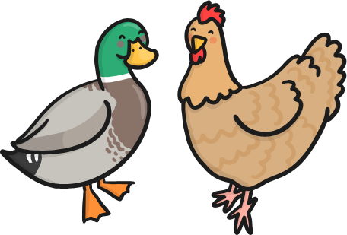
a duck and a hen

Slide 23
on top of the rock

Slide 24
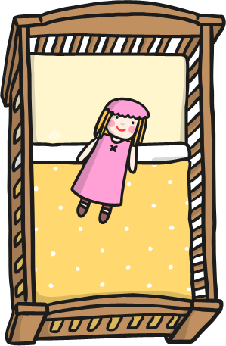
a doll in a cot

Slide 25
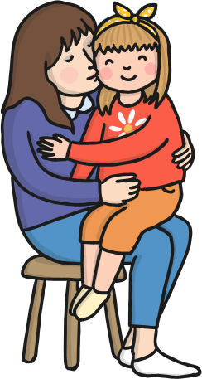
a hug and a kiss

Slide 26
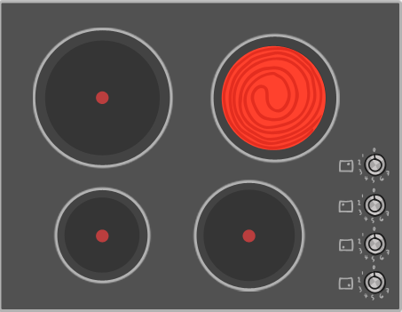
a hot hob

Slide 27
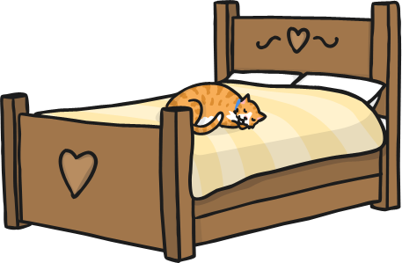
a cat on a bed

Slide 28
go to the log hut

Slide 29
mugs and cups

Slide 30
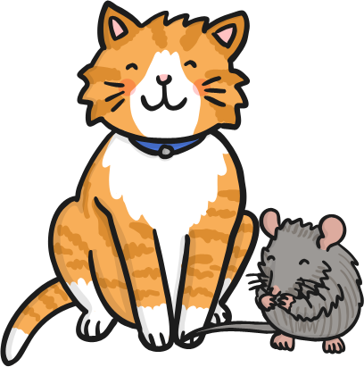
a cat and a big
fat rat

Slide 31
an egg in an
egg cup

Slide 32
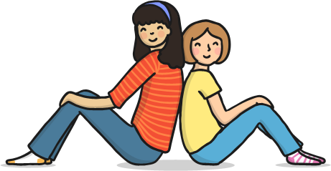
sit back to back

Slide 33
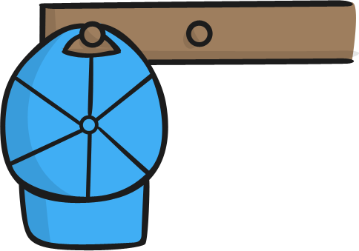
a cap on a peg

